Slide 1
NLP Section 3
Text Preprocessing

Slide 2
Preprocessing
Data preprocessing is the first step in any data analysis or machine learning pipeline
Cleaning, transforming and organizing raw data to ensure that it is ready for modeling

Slide 3
Text Cleaning
Text cleaning depends on the context, sometimes you remove certain components of the text and sometimes not.
Typically involves cleaning the following: 1- Symbols 2- Numbers 3- Punctuations 4- Extra White spaces

Slide 4
Spell Checking
Spell checking is the process of correcting miswritten text typically using a dictionary
Most famous tools: 1- Textblob 2- Symspell (superior)

Slide 5
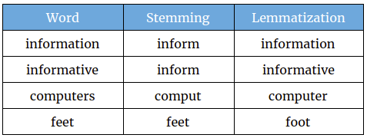
Normalization
Text normalization involves either stemming or lemmatization
Lemmatization is almost always better than stemming

Slide 6
Stopwords
Stopwords such as: - a - of - on - I and so on.. are typically not important for analysis purposes.

Slide 7
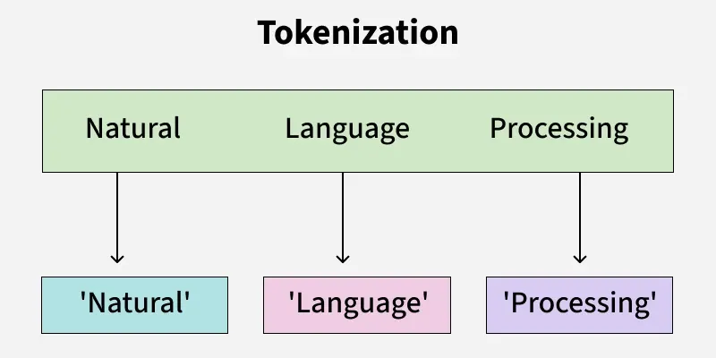
Tokenization
The process of splitting text into tokens
A token can be a subword or a combination of words depending on the technique

Slide 8
Code
Practice and showing the difference between preprocessed text and non-processed text and how it affects the outcome

